Slide 1
PC2232 Physics for Electrical Engineers
Lecture 0: Introduction

Slide 2


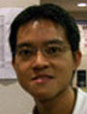
Our Team : Lecturer & Tutors
A/P Sow Chorng Haur
S12-02-19
Tel: 6516 2957
physowch@nus.edu.sg
Research interest: Experimental Condensed Matter Physics, Nanoscience, Physics Education
Ms Angeline Shu
S13-04-08
6516-2617
physhua@nus.edu.sg
Mr Lim Yen Kheng
S12-02-12
6516-2625
phylyk@nus.edu.sg

Slide 3
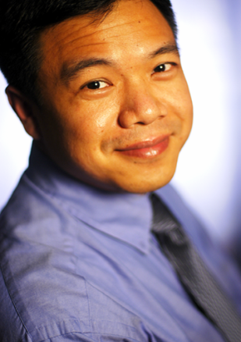
Who is this guy?
NUS - B.Sc Physics Honours (1st) (Applied Nuclear Physics, played with very energetic proton particles!)
NUS - M.Sc Physics (Nuclear Microscopy, squeezing proton beam into tiny spot)
U. of Chicago - Ph.D. (Experimental Condensed Matter Physics - Took pictures of Magnetic Vortices in Superconductors; Used miniature cantilevers)
Bell Labs - Postdoc (Optical Tweezers; Colloidal System - Small tiny plastic balls floating in water.)
NUS – Associate Professor (Microspheres, Carbon Nanotubes, AFM, Blood Cells, DNA, Oxide Nanowires, Field Emission, Nanofabrications, Assembly … Still having fun!!)
NUS Teaching Academy (Fellow of NUS TA)
Research in Pedagogy and Education

Slide 4
Approximate Coverage
Basic concepts of modern optics (Weeks 1 – 3)
  Maxwell’s Equations, wave equations, plane EM waves, standing EM waves, Poynting vector, power, polarization, reflection, refraction, interference, diffraction; EE related applications (optical waveguides, optical data storage systems)
Introduction to quantum mechanics (Weeks 3 – 4)
  Blackbody radiation, photoelectric and Compton effects, atomic spectra, the de Broglie hypothesis and uncertainty principle.

Slide 5
Approximate Coverage
Wave function and quantization (Weeks 5 – 7)
  Schrödinger equation (wave function, probability, charge density, current density), free particle, quantum confinement (harmonic oscillator, 1D, 2D, 3D potential wells), quantization of energy, ground state and tunneling; EE related applications (semiconductor quantum wells, quantum wires and quantum dots).
Hydrogen atoms, atomic bonding, solids (Weeks 8 – 10)
  Particle in central potential, hydrogen atom, angular momentum, electron spin, atomic states, atomic bonding, solid, periodic potentials, energy band, metal, insulator and semiconductor

Slide 6
Approximate Coverage
Optical transition in atoms and solids (Week 11 – 13)
  Optical transitions between atomic levels, spontaneous emission, absorption, stimulated emission, laser; EE related applications (LEDs, LDs, optical communications, DVDs, and display technologies)
This is only a very rough guide. The timing is only approximate, and the order which some of the topics will be taught may also be switched to enhance your understanding.

Slide 7
Organization of module
Lecture | Wed 8 – 10 am (LT6), Fri 10 – 12 noon (LT6)
Tutorial | Once a week – starts 3rd week.
Practical | 2 experiments for whole semester – in Physics Dept See your lab schedule.
Term Test | 1 h 30 m: 20 MCQs. On Week 7 (March7, 10-12pm)
Exams | Final closed book written examination. 2 hours duration. May 5, 1pm
Public holidays in this semester that affect us –
Chinese New Year: 31 Jan (Friday)
Good Friday: 18 April (Friday)

Slide 8
Module Workload
Activities | Hours / week | Semester Total
Lectures | 3.0 | 34.5
Tutorials | 1 | 10
Labs | 0.5 | 6
Preparation for class | 5.5 | 72*
Total | 10 | 121*
* Approximate - excludes public holidays and term test.

Slide 9
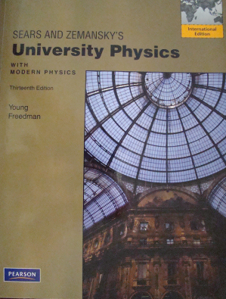
Recommended Textbooks
No single textbook covers the topics adequately. You can obtain all the fundamental ideas from any introductory University Physics textbook, e.g.,
University Physics
Young & Freedman (13th Ed, 2011)
Pearson – Addison Wesley
  Physics for Scientists and Engineers – Serway & Jewett, Thomson – Brooks/Cole
  Fundamentals of Physics – Halliday, Resnick and Walker, John Wiley
  University Physics – Bauer & Westfall, McGraw Hill

Slide 10
Supplementary textbooks
More advanced examples and applications will be taken from other sources and we will indicate them in the lectures, e.g.,
  Optics
    Hecht, Addison Wesley
    Pedrotti, Pearson Addison Wesley
  Modern Physics –
    Randy Harris, Pearson Addison Wesley
    Bernstein, Fishbane & Gasiorozicz, Pearson Prentice Hall
  Quantum Mechanics –
    Bransden & Joachain, Pearson Prentice Hall
There are also textbooks meant for engineers which you may also refer to, e.g.,
  Engineering Physics – Fundamentals & Modern Applications – Khare & Swarup, Infinity Science Press

Slide 11
Assessment
 | % | Components
1 | 10 | Practical – discussion / viva & report,
2 | 10 | Tutorials (attendance, participation, etc.)
3 | 20 | Term Test
4 | 60 | Final written examination

Slide 12
Lectures
Encouraged to attend all lectures.
Will try to include demonstrations, computer simulations, movies that illustrate principles.
PPT slides to be uploaded into IVLE (before lectures if possible). Additional slides / solutions to problems after the lectures.
Try to start and end on time (effort of lecturer & students).
Download Lecture slides from
    IVLE – PC2232 – Workbin – Lectures

Slide 13
Group Tutorial
Conducted in every week starting from Week 3.
10 tutorials in total.
Problems will be given in advance, you are strongly encouraged to attempt them before coming to the discussion.
Attendance will be taken and tutors will organize tutorials in a way that encourages discussion and teamwork – it’s also about learning and collaboration.
Some questions may be set as assignments to be handed in during tutorials.
May also use classroom feedback systems (clickers) for interactive learning.

Slide 14
Practical (10%)
In total, 2 laboratory sessions (each 3 hours):
  Diffraction (Weeks 4 – 7)
  Scanning Tunneling Microscope (STM) (Weeks 8 – 13)
Venue: Physics-E Lab, S11 03-02 (in Physics Dept.)
If absent, please arrange another session with Ms Foo Eng Tin: phyfooet@nus.edu.sg or at above venue as soon as possible.
Each session consists:
  Short Group Briefing
  Carry Out Experiment in Pair (1st expt) / group of 3 (2nd Expt)
  Viva (Oral Examination) – Individual
  Individual report (to be submitted within 24 hours after the experiment)

Slide 15
Term Test (20%)
Format: 20 Multiple Choice Questions
Duration: 1 hour 30 min
Date: March 7 (Friday)
Time: 10am to 12pm
Venue: To be finalized (MPSH 1)
Coverage: Optics and Quantum Physics (first half)
Still subjected to change – please treat as tentative.

Slide 16
Written Examination (60%)
Format:
5 Short Qns (10% each), 2 Long Qns (25% each)
      (all compulsory)
Duration: 2 hours
Date: May 5
Time: 1pm
Venue: To be announced
Coverage: Everything (but slightly more emphasis on those not covered in test)
Still subjected to change – please treat as tentative.

